Slide 1
CS4232 Lab
Week 8

Slide 2
Lab Content
[This Week]
GLCM-based Texture Analysis
Laws Filters
Gabor Filters

Slide 3
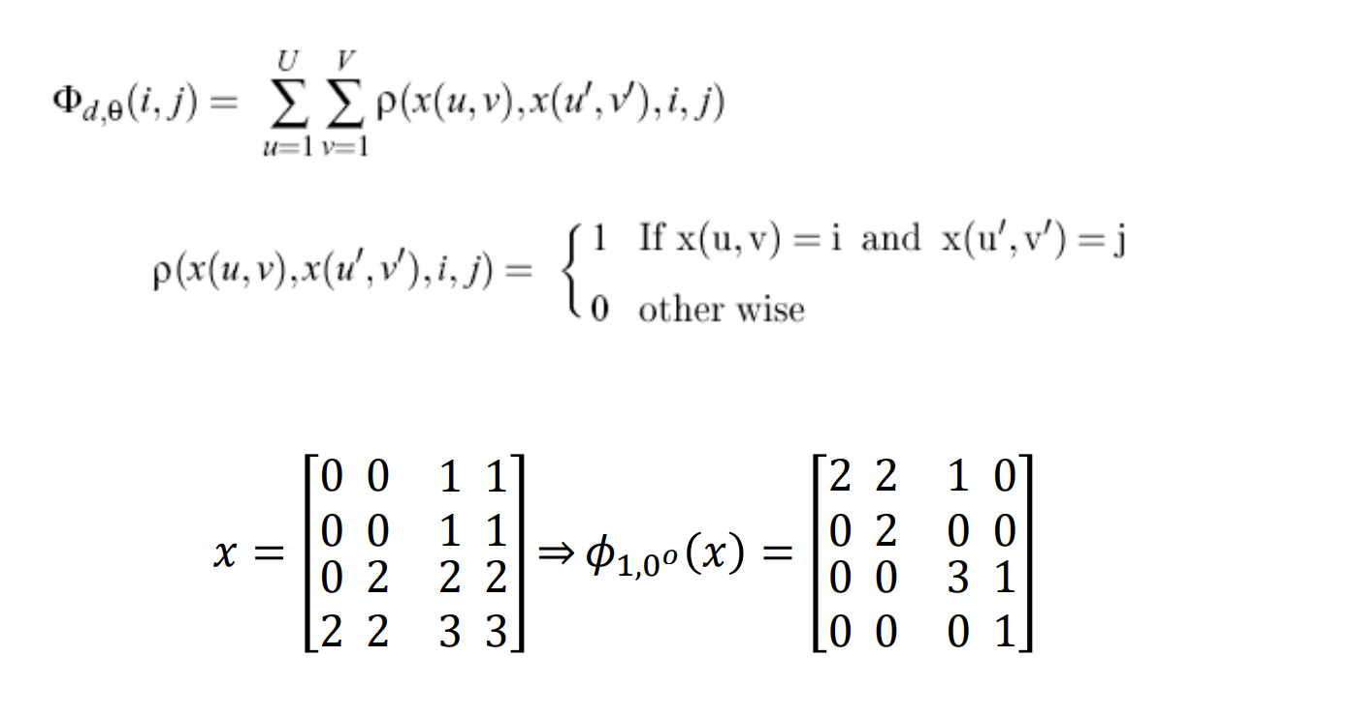
GLCM
Grey-level Co-occurrence Matrices
Co-occurrence matrix methods are based on the repeated occurrence of some gray-level configuration in the texture;
This configuration varies rapidly with distance in fine textures and slowly in coarse textures.

Slide 4
Functions to be applied on GLCM matrices:

Slide 5
If the element values ​​of the co-occurrence matrix are similar, the energy is small, indicating a fine texture; if some values ​​are larger and some are smaller, the energy is larger, indicating a uniformly changing texture.

Slide 6
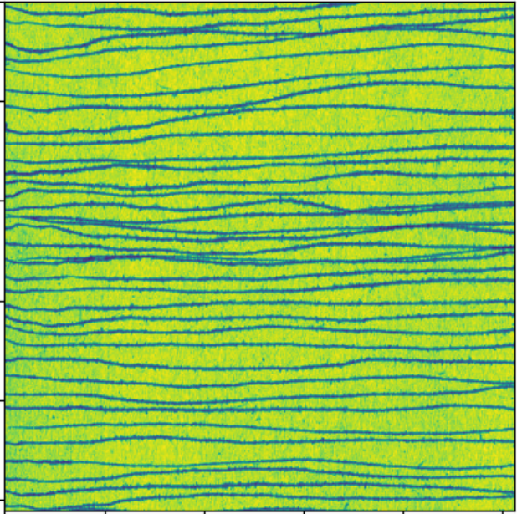
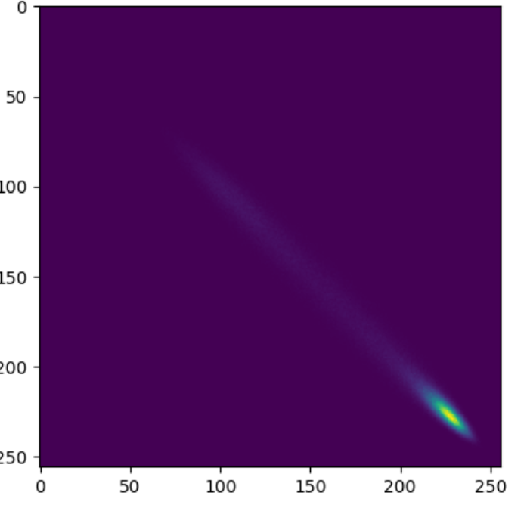
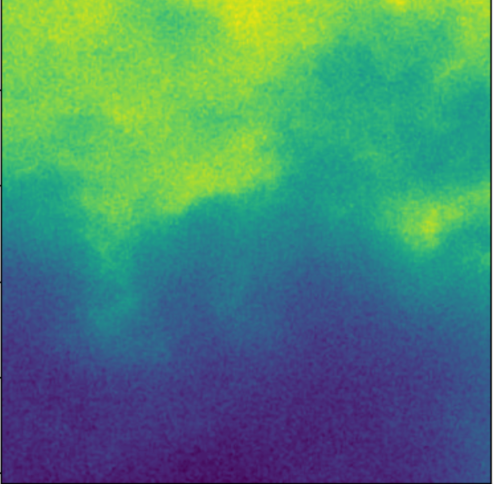
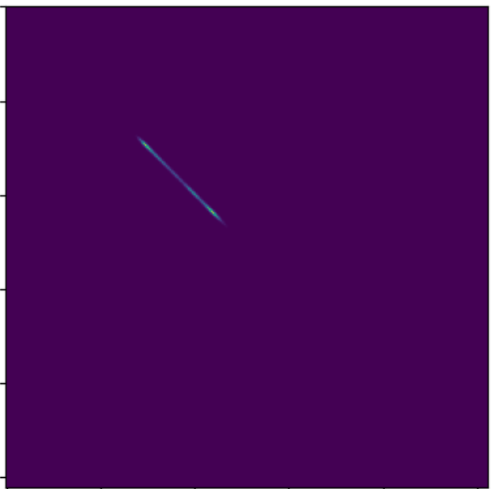
Example
(F1,F2) =(1005.0, 76882028.0)
(F1,F2) = (7975.0, 896106400.0)

Slide 7
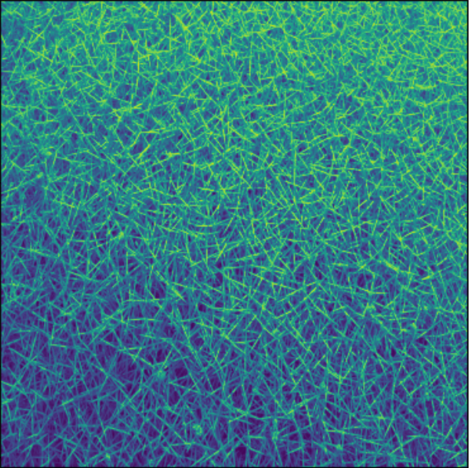
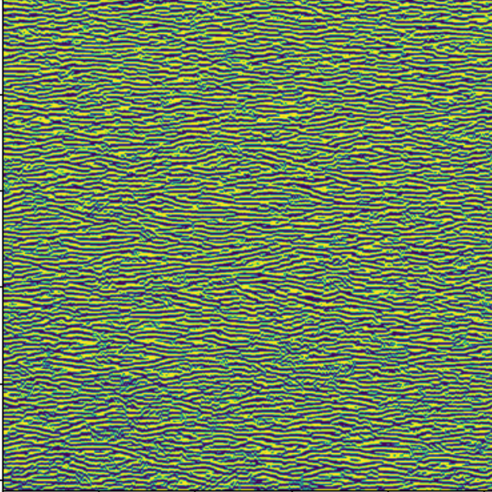
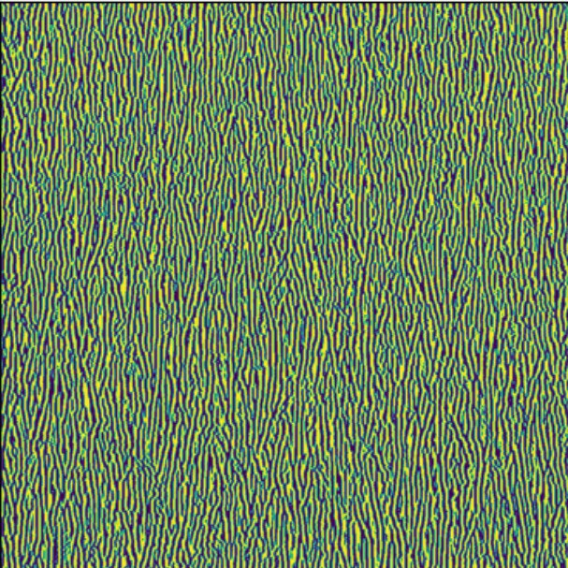
Gabor Filters:
Gabor filters are a representation of the conversions of an image using filters that apply different variations of scales and orientations.

Slide 8
End of Lab

